Slide 1



Shri Ramswaroop Memorial college of engineering and management
Farming Web Assisting Services
Project Progress Report - 2
Project Guide :- Er. Abhishek Dubey
Aviral Jaiswal (2101220100035)
Himanshu Singh Chauhan(2101220100054)
1

Slide 2
Content
01
Project Objective
02
Project Methodology
03
Modules
04
Work Completed
05
Work in progress
06
Block of code
07
Output
08
Difficulties
2

Slide 3
Project Objective
To develop and create a digital platform that provides valuable support and resources to the farmers, agricultural workers, and stakeholders in the agricultural industry which could address various challenges and needs within the farming sector.
To facilitate connections between farmers and potential buyers such as wholesalers, retailers and consumers.
To reduce the cost and develop an economical and user-friendly GUI application.
To provide suggestions based on a current world to eliminate the need to translate the full term.
3

Slide 4
Project Methodologies
Here's a concise overview of how the Iterative Waterfall model applies to the Farming Web Assisting Services project:
1)Requirements Analysis:
Gather and refine user requirements through iterative feedback.
2)System Design:
Create a solid design, tested and refined in iterations.
3)Implementation:
Develop features in phases, adjusting based on continuous feedback.
4)Testing:
Test early and throughout development, refining as needed.
5)Deployment:
Deploy the system, then refine with incremental updates.
6)Maintenance:
Continuously improve the system with regular updates based on evolving needs.
4

Slide 5
Modules Developed
01
02
03
Login Page
Farmer Adding Process
Farmer Registration
A login page module handles user authentication by verifying credentials and granting access to authorized users
The farmer adding process module enables administrators to register and manage farmer details in the system
A system that allows farmers to register by providing their name, contact details, farm size, location, and crop type, storing the data securely for future reference
5

Slide 6
Work Completed
The User Login frontend module is ready.
The farmer login frontend part is ready.
The authentication page has been designed.
The welcome page is designed.
The complaint page is designed.
The frontend part is 68% ready.
6

Slide 7
Work In Progress
The work on backend part has been started.
The interfacing part is to be made.
Working on other modules as well.
Progress Percentage :-70%
7

Slide 8
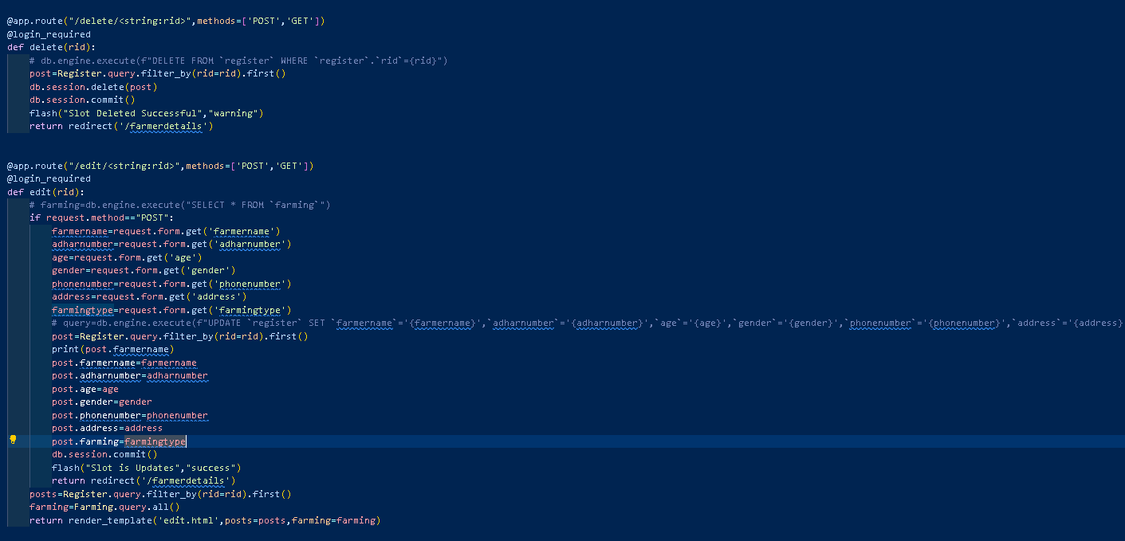
Block of Code-Login Page
8

Slide 9
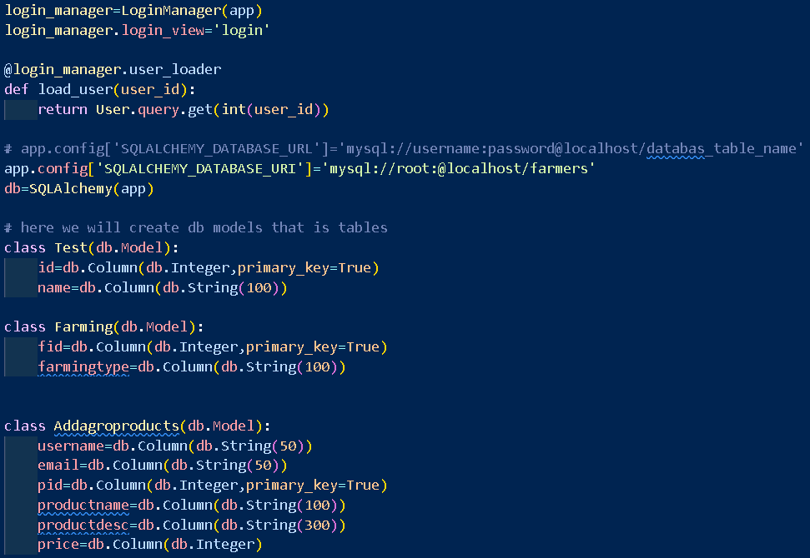
Block of Code-Farmer Adding Process
9

Slide 10
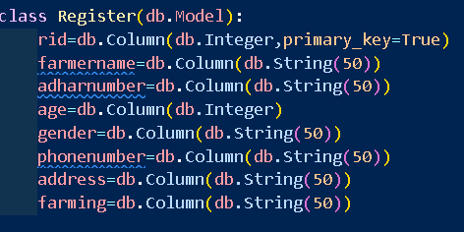
Block of Code-Farmer Registration
10

Slide 11
Difficulties Faced
Facing error in recently designed modules.
Facing problem in python backend language so using PHP as an alternative.
Interfacing issues.
11

Slide 12
Thank
You
12

